Slide 1

DRUG RECOMMENDATION SYSTEM
AYUSHI PRASAD : MT2023145
DRISHTI GUPTA : MT2023099
DEEPANJALI GHOSH : MT2023119
ANANT PANDEY : IMT2020524

Slide 2

INNOVATING HEALTHCARE
Say hello to our intelligent drug recommendation system
This project explores the feasibility of utilizing customer reviews to develop a drug recommendation system.
The project investigates sentiment analysis techniques to analyze the vast amount of textual data present in customer reviews of medications. By identifying positive and negative feedback on factors like effectiveness and side effects, the system can learn user experiences and recommend drugs with a higher likelihood of patient satisfaction.

Slide 3
Current challenge and our Solution
Current Challenge:
Selecting the most effective medication for a patient can be time-consuming
Doctors may not have access to all patient experiences with specific medications
This can lead to trial-and-error prescribing
Our Solution:
Reduce trial-and-error prescribing: By highlighting medications with a lower likelihood of side effects based on patient experiences.
Improve treatment outcomes: By recommending medications with a higher reported success rate based on patient reviews.

Slide 4
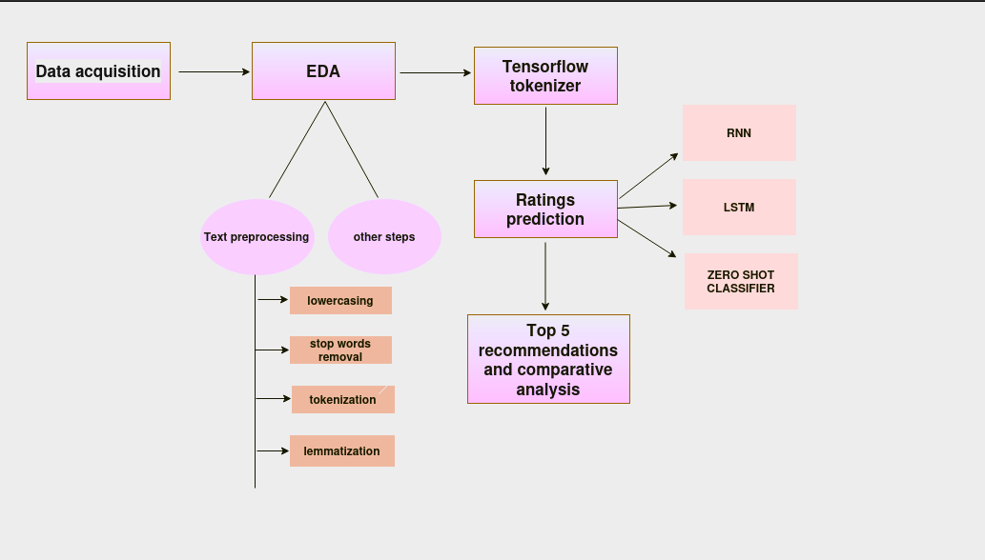
Project Flow

Slide 5
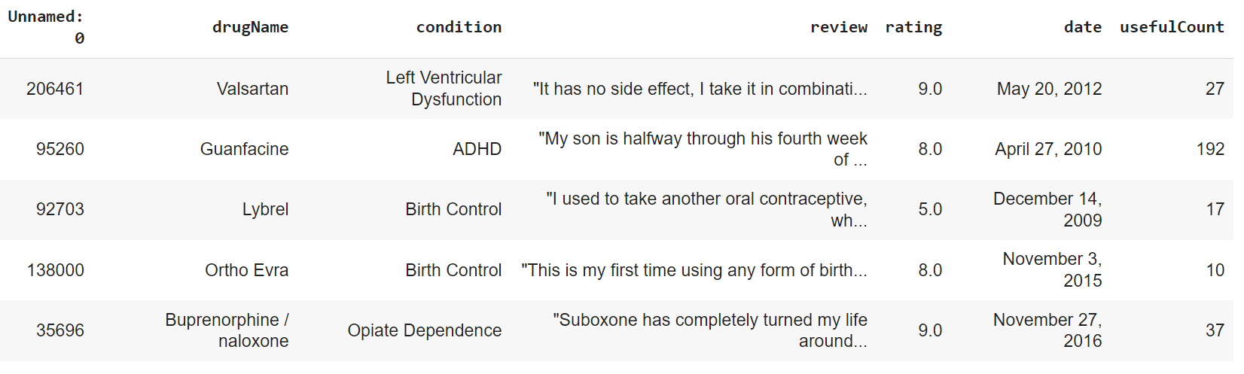
About Dataset
We got dataset from University of California,Irvine ML Repository.This dataset consists of columns user_id,drugName,condition,review,rating,date and usefulCount.It has 215063 rows and every user has given 1 review only.It has 916 conditions.Ratings are ranging from 1 to 10.

Slide 6
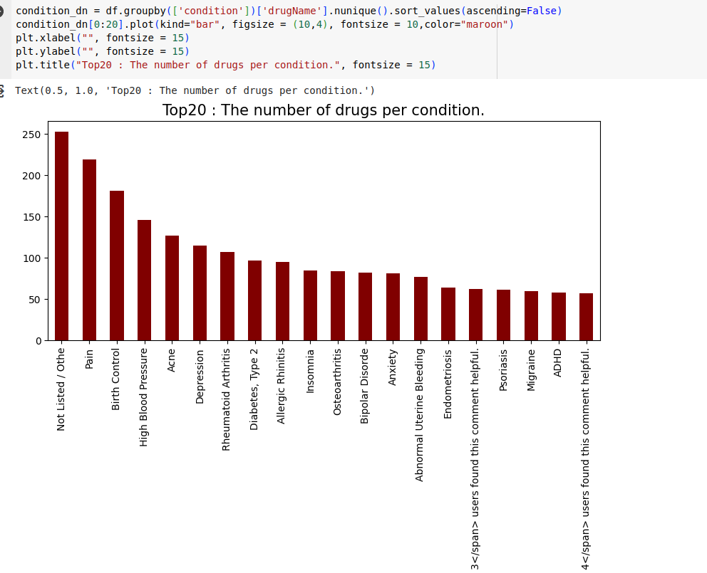
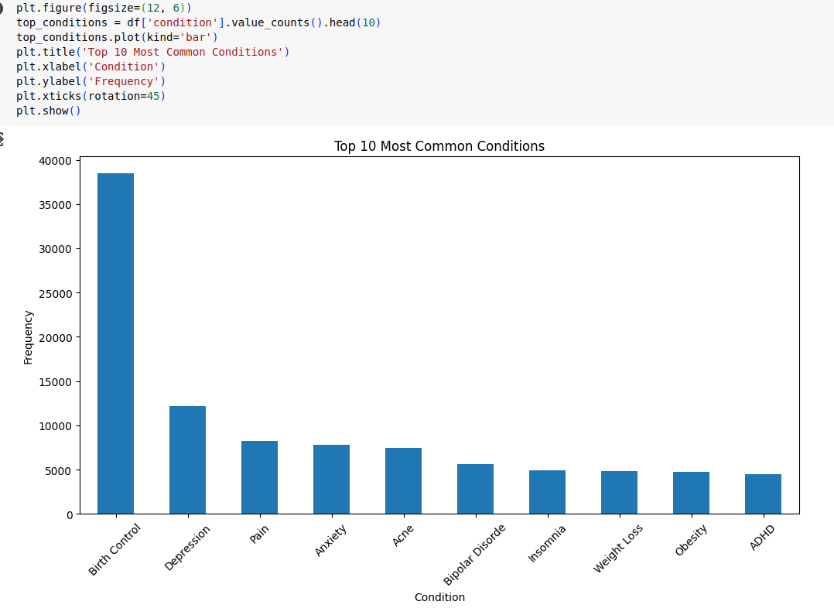
Analysis of our Dataset (EDA):
1)No of drugs per conditions(top 20) 2)Top 10 most common conditions

Slide 7
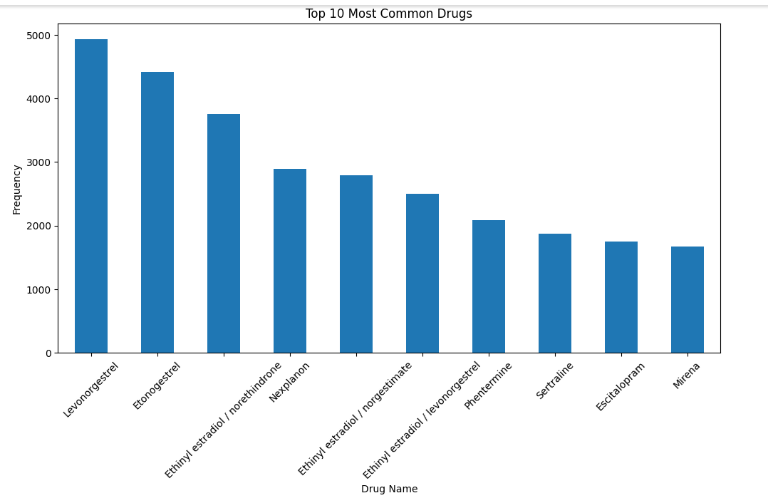
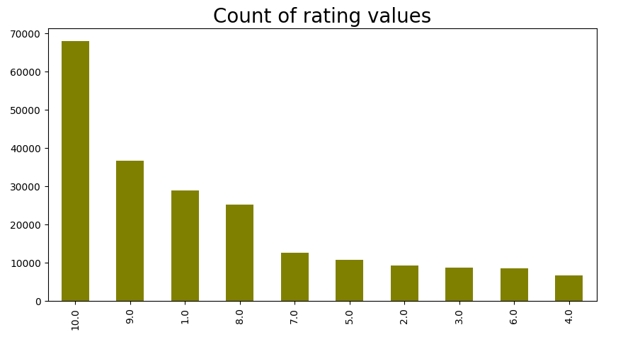
Analysis of our Dataset :
3)10 Most common Drugs 4)Count of rating values

Slide 8
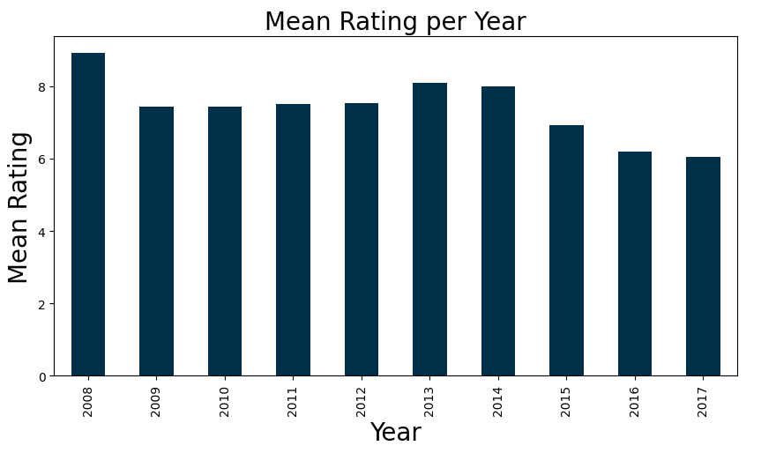
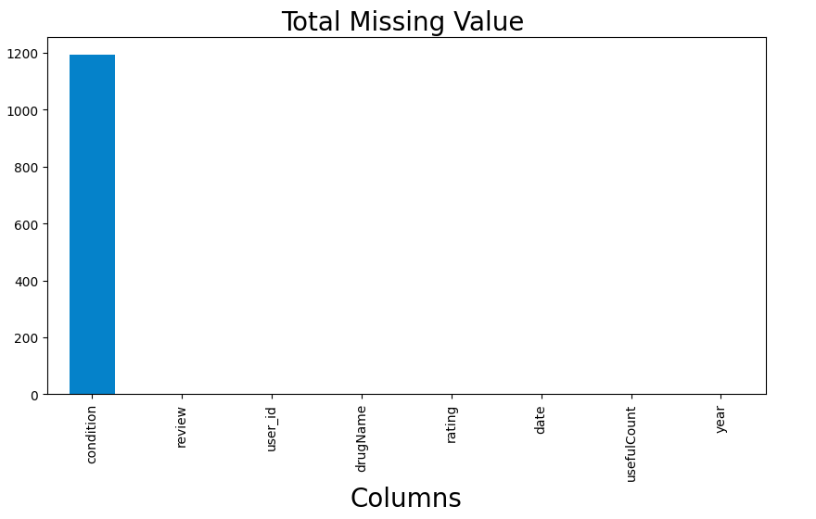
Analysis of our Dataset :
5)Mean Rating per year 6)Total Missing Values

Slide 9
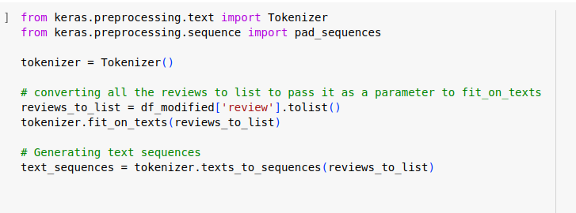
Tokenization :
Why tokenization?
Text Representation: Tokenization converts raw text data into a format that machine learning models can understand. It breaks down text into meaningful units (tokens) such as words or subwords.
Feature Extraction: Each token becomes a feature that the model can use for analysis. This process is crucial for extracting meaningful information from text data.
Vocabulary Creation: Tokenization creates a vocabulary of unique tokens present in the text corpus. This vocabulary is essential for mapping words to numerical representations.
Text Normalization: Tokenization helps in normalizing text by handling variations like capitalization, punctuation, and special characters, ensuring consistent input for the model.

Slide 10
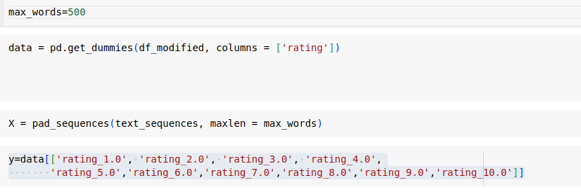
Padding Sequence :
Why Sequence Padding ?
Fixed Input Size: In deep learning models, input sequences need to have a consistent length. Padding ensures that all sequences are of the same length by adding zeros or a special token to shorter sequences.
Batch Processing: Padded sequences enable efficient batch processing during training, as all sequences within a batch have the same length. This speeds up computation and improves model training.
Avoiding Information Loss: Padding prevents information loss in shorter sequences. Without padding, shorter sequences would be truncated, leading to loss of valuable data and context.
Compatibility with Models: Many deep learning models require fixed-size input, making padding an essential preprocessing step. It ensures that the input data format aligns with the model's requirements.

Slide 11
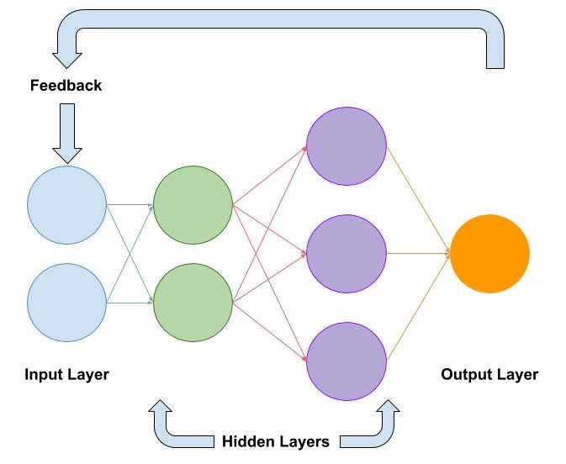
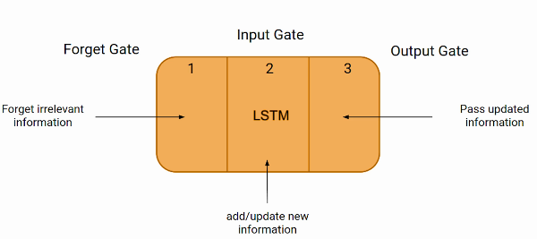
Models Used :
1)Simple RNN 2)LSTM

Slide 12
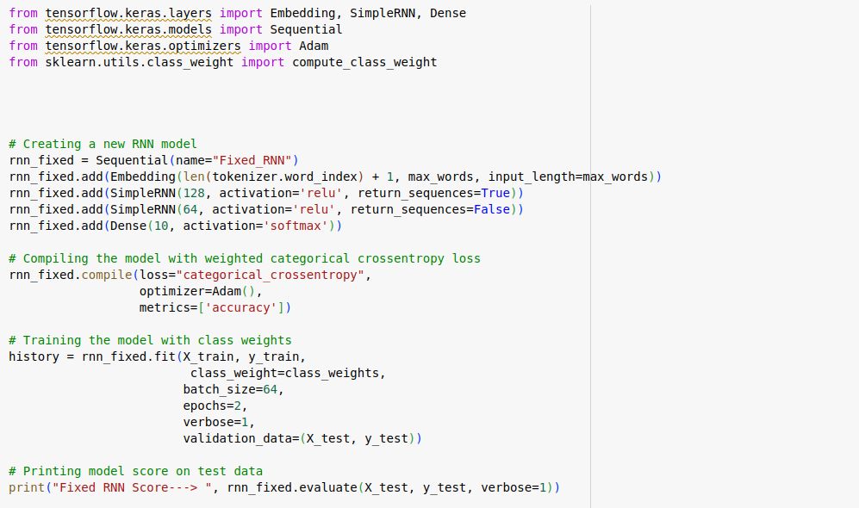
Simple RNN :
Approach used:
Created a Sequential model named "Fixed_RNN" using TensorFlow and Keras.
Added layers:
Embedding layer: Transforms integer-encoded tokens into dense vectors.
SimpleRNN layers: Utilized two SimpleRNN layers with relu activation and appropriate units.
Dense layer: Output layer with softmax activation for multiclass classification.
Compiled the model with:
Loss function: Categorical cross-entropy for multiclass classification.
Optimizer: Adam optimizer for efficient gradient descent.
Metrics: Accuracy metric to evaluate model performance.
Trained the model:
Used class weights to handle imbalanced data and improve model learning.
Trained on training data with batch size 64 and 2 epochs.
Validated on test data to assess generalization performance.
Evaluated model performance:
Calculated and printed the model score (loss and accuracy) on the test data.

Slide 13
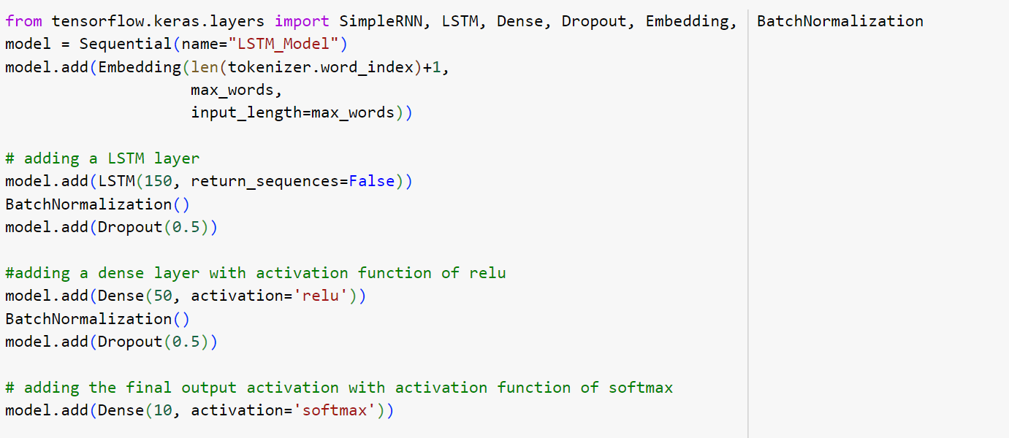
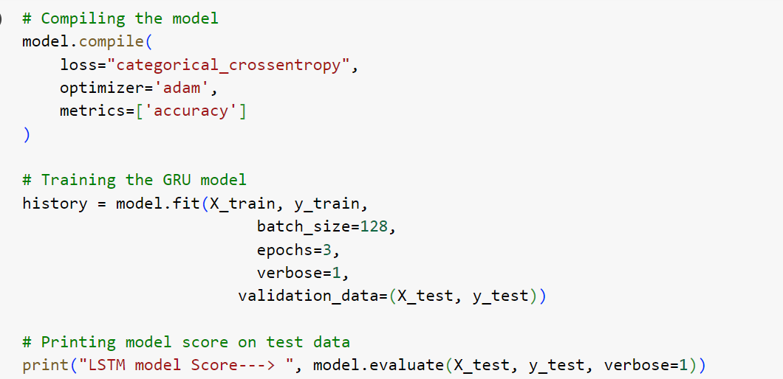
LSTM :
Approach used:
Created a LSTM layer with 150 nodes and a dense layer with 50 nodes and activation function “relu”.
In output layer we have 10 nodes and activation function “softmax”.
Loss used is cross entropy loss.
Trained the model on training data with batch size of 128 and 3 epochs.
Validated on test data to assess generalization performance.
Calculated and printed the model score on test data.

Slide 14
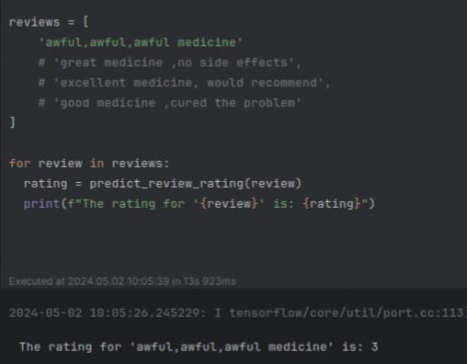
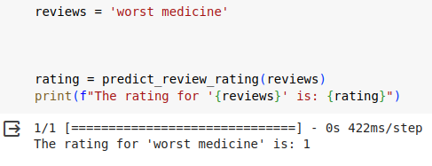
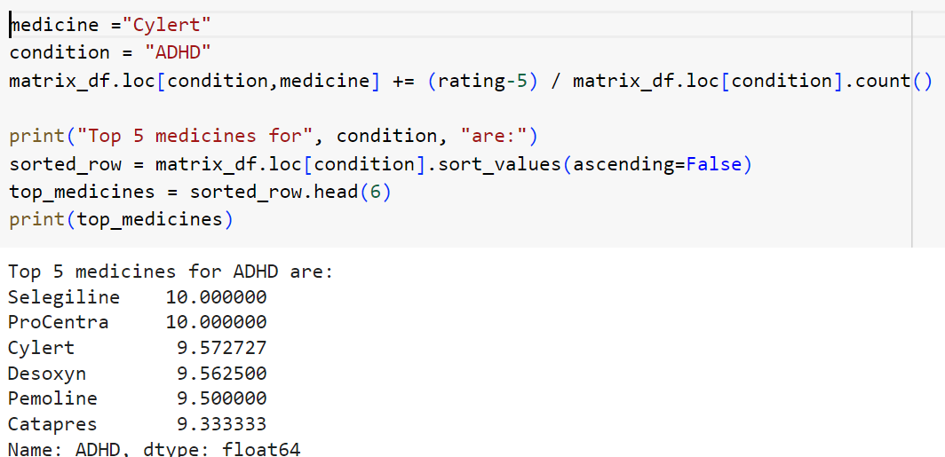
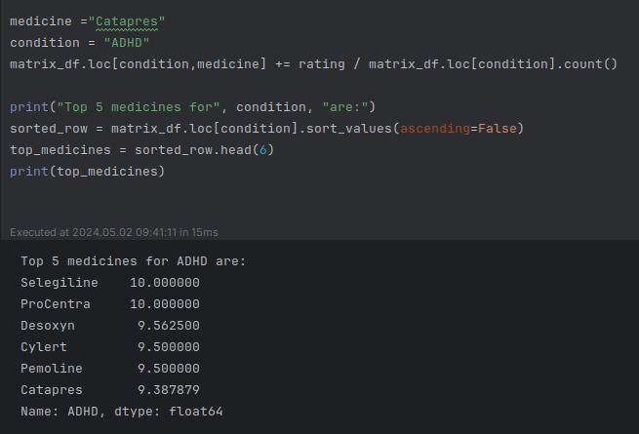
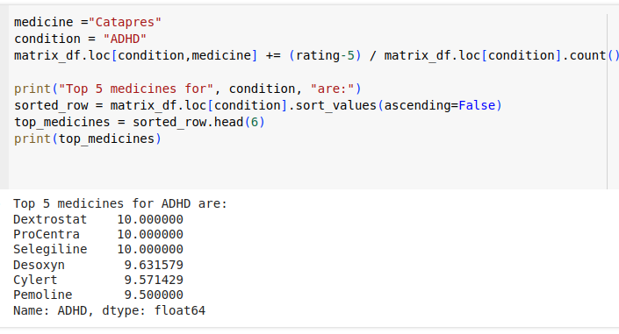
Comparisons of recommendation of our models with Pretrained Model :
1)Simple RNN 2)LSTM 3)Zero Shot Classifier

Slide 15
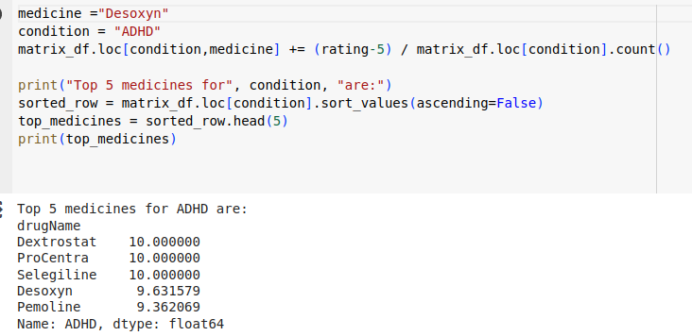

Impact of User Reviews on Recommendation:
Continuous negative reviews lead to a decrease in average rating for a medicine.
Over time, this decline can result in the medicine being excluded from the top 5 recommended list.
Continuous positive reviews contribute to an increase in the average rating for a medicine.
This upward trend can lead to the medicine gaining a position in the top 5 recommended list over time.

Slide 16
Future Scope :
Implementing BERT for Deeper Insights
BERT Overview:
State-of-the-art NLP model capable of understanding context in text
Pre-trained on a large corpus and fine-tuned for specific tasks
Advantages of Using BERT:
Enhanced understanding of language used in patient reviews
Improved sentiment analysis leading to more accurate drug ratings
Implementation Strategy:
Fine-tune BERT on healthcare-specific datasets including patient reviews
Compare performance against current LSTM and RNN models
Specialized Feature Handling: Side Effects
Current Limitations:
Reviews mentioning side effects are treated the same as other reviews
Proposed Feature: Side Effect Weighting
Detect mentions of side effects using keyword extraction or NLP classification
Assign negative weightage to reviews mentioning side effects
Impact:
Prioritize drugs with fewer harmful side effects in recommendations
Increase the safety and satisfaction level of recommended drugs

Slide 17

Thank You
AYUSHI PRASAD : MT2023145
DRISHTI GUPTA : MT2023099
DEEPANJALI GHOSH : MT2023119
ANANT PANDEY : IMT2020524

